Slide 1
Final_Project
File created on: 09-10-2022 00:09:19

Slide 2
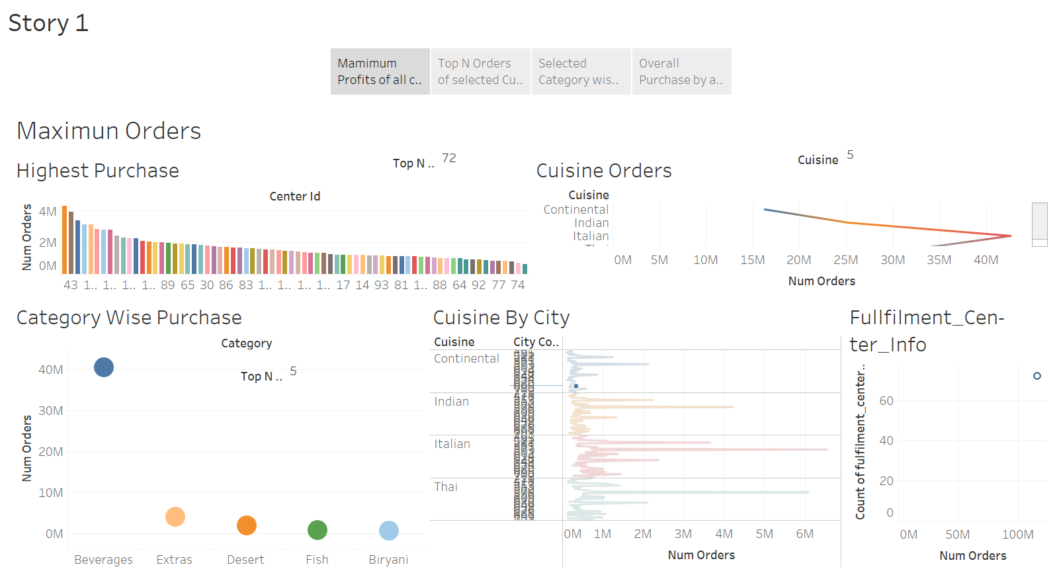

Slide 3
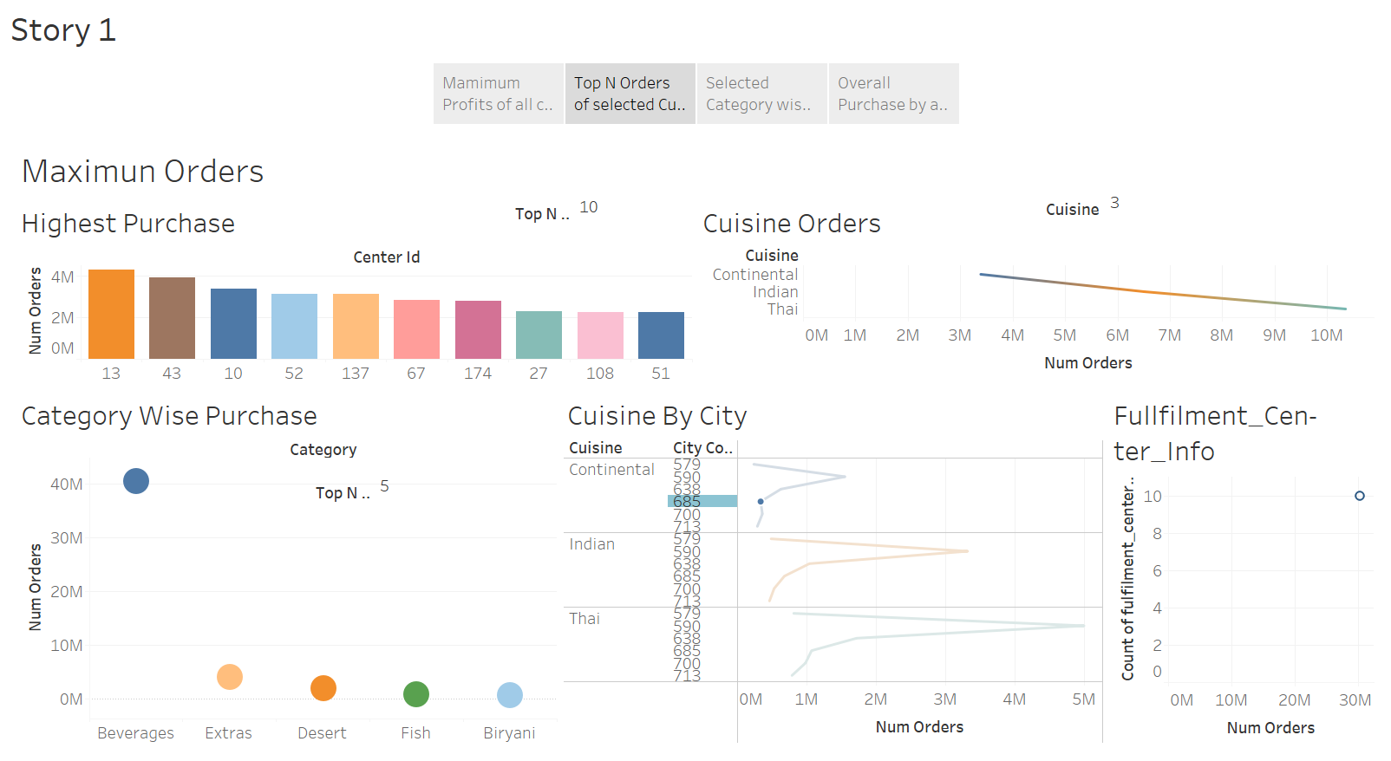

Slide 4
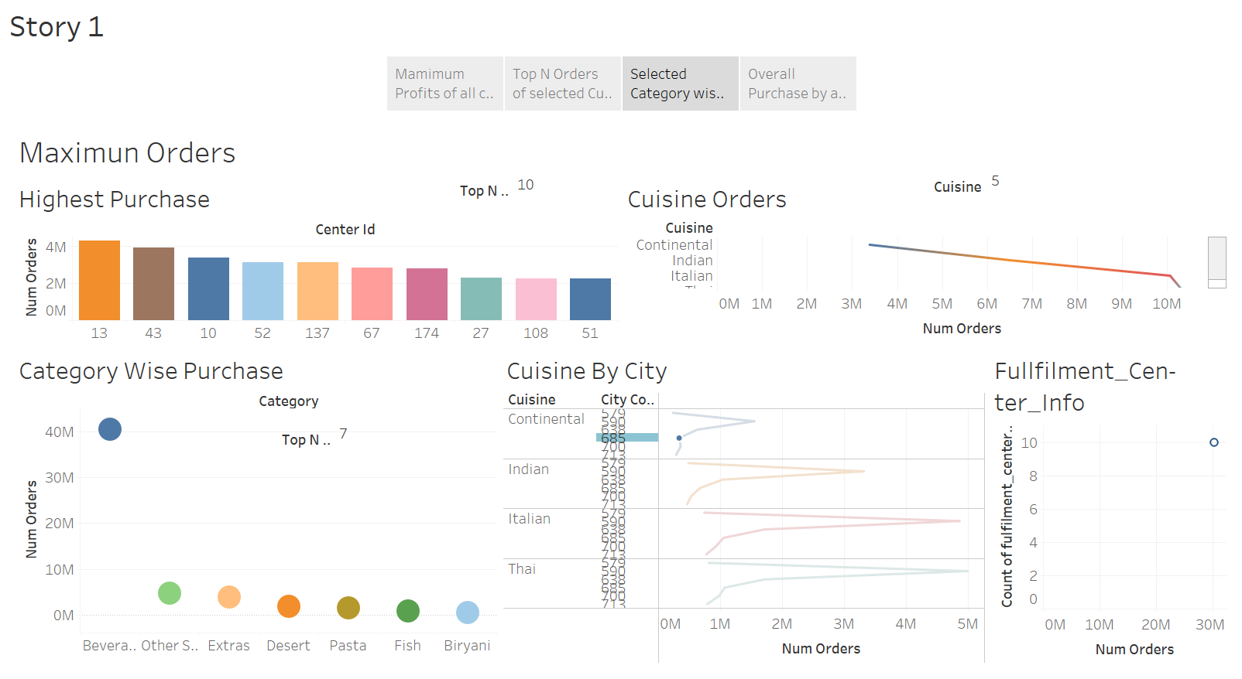

Slide 5
